Slide 1
Final Submission
Foundation Project -1
Food Recommendation System
SUBMISSION BY
  Deep Kamal Singh (12020053)
  Kshitij Sharma (12020062)
  Mohua Sinha (12020015)
  Nidhi Srivastava (12020078)
  Soumaya Ranjan (12020060)

Slide 2
Project Background
Business Context
Need of the Hour
Consumers now have a variety of food choices, and comfort of Home delivery along with dine-out.
Abundant outlets for dining out or home delivery,
Several food aggregator sites and apps to compare restaurants based on ratings, safety and hygiene, deals, and distance etc.
  Accelerated Customer Satisfaction
  Realtime 360° Feedback mechanism
  Enhance profitability and measured economic success
Recommendation Systems Limitations
Unexplored potential
  Seasonal moods affect consumer tastes and preferences
  Little to no personalization on food suggestions
  Limited tracking on gastronomical compatibility
  CRISP-DM
  Using the big data
  Distributed Computing
  Mathematical Modelling

Slide 3
Evolution of Food Recommendation System
Recommendation using ant colony algorithm to generate optimal food list suiting food according to medical reports.
Recommendation Ensemble learning algorithms
Using a set of models to generate a prediction
Most Simplistic of models is recommendation using Simple Content Based Filtering
Similarity based on certain parameters like cuisine/Menu combination.
Recommendation using Naïve Baye’s classifier – Collaborative filtering
Similarity is identified based on age , native place, gender etc. which is used in determining similarity and generate recommendation based on preferences and past history
Recommendation using Latent factor Collaborative technique
Based on the assumption that the factors responsible for the user’s choice on an item need not to be explicitly known.
Notes:
FP growth at an ingredient level (ALS –Using Netflix)
Live A & B testing—Differently tuned parameters…Evaluation based on model performance --Learning
https://ijarcce.com/upload/2017/april-17/IJARCCE%202.pdf
. Collaborative filtering approaches building a model from a user‟s past behaviour (items previously purchased or selected and/or numerical ratings given to those items) as well as similar decisions made by other users. This model is then used to predict items (or ratings for items) that the user may have an interest in. Content-based filtering approaches utilize a series of discrete characteristics of an item in order to recommend additional items with similar properties. Combination of these two systems is Hybrid system
Different people have different food preferences and dietary restrictions. A noticeable similarity is found in people belonging to same categories based on attributes like age, native place, gender, work-type, etc. which can help to relate individuals and their dietary preferences.A collaborative IJARCCE ISSN (Online) 2278-1021 ISSN (Print) 2319 5940 International Journal of Advanced Research in Computer and Communication Engineering ISO 3297:2007 Certified Vol. 6, Issue 4, April 2017 Copyright to IJARCCE DOI10.17148/IJARCCE.2017.6402 7 approach based recommendation system can be designed to provide restaurant recommendations to people based on their preferences andpast history.

Slide 4
Business & Data Understanding
Data Preparation
The Modeling and Evaluation
Deployment
Monitoring and Maintenance

Slide 5
Business & Data Understanding

Slide 6
Business Objectives and Success Criteria
Business Problem
Business Success criteria
Increase in footfalls/order volume
Increase in order volume per order by cross-selling
other popular food items
Increase the likeability factor/positive reviews
helping further revenues
Present food recommendation engines are not effective
Significant churn on the account of limited/sub-optimal choices to customers, impacting future sales and retention
Business Objective
ML Success Criteria
Maximize revenue by providing the most preferred and likeable food options
Accuracy (Successful recomm/ Total recomm)
Precision (TP/ (TP+FP)) & Recall TP/(TP+FN)
RMSE
F1 Score = 2*(Recall * Precision) / (Recall + Precision)
Business Constraints
Economic Success Criteria
Minimize consumer fatigue by providing most optimal choices
Minimize the searching time for the preferred choices
Click through rate (CTR)
Conversion rate overall/Conversion rate per user
Proportion of orders with recommendations
Recommend items per order
Notes:
Could not rea predict the ..we 80% Accuracy and 0.3 should be click through rate

Slide 7
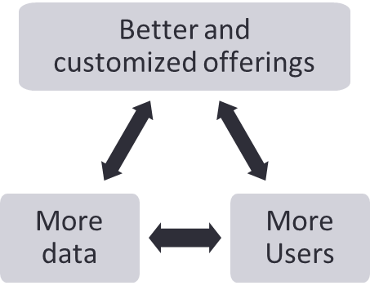

ML Feasibility and Legal Constraints
Applicability of ML technology
Requirements on the application
Legal Constraints
    ML application
  Consumer perspective
    Basic information in terms of demographic information, reviews, food preferences, allergies in line with “Terms of Reference”
  Food outlet perspective
    Information around the menu, ingredients, services
    Three broad categories of Constraints around “User privacy” are :
    Non-adherence to policy approaches (GDPR legislation) to regulate data collection, use, and storage
    Inadequate Privacy-enhancing architectures- privacy risks of storing user data in separate and decentralized databases
    Improper algorithmic solution (encryption) with the risk of losing the data to external agents for unwarranted usage
    Data Biases – biased data (Similarity, Expedience, Experience, Distance, Safety)
    Beyond the traditional ranking mechanism of ratings and location
    Leverages additional contextual information such as day, mood, season, user information like allergies
Inputs
Recommendations to users
Notes:
Applicability of ML technology
Many food outlets / aggregators have tons of users and therefore tons of data. However, the virtuous cycle (More data-à Better and Customized offerings-à More Users -àMore data) has not picked because of the lack of knowledge on how to convert their user data into actionable insights at a feature level (e.g.: cuisine level), which can then be used to improve their product or services.
ML based technology goes beyond the traditional ranking mechanism of ratings and location allows to rank the prefiltered dish and restaurant candidates based on additional contextual information such as day, mood, season, user information like allergies etc. ML based technology leverages many supervised classification methods for ranking and some of the techniques used are Logistic regressions, Support Vector mechanism, Decision tree-based method such as Gradient Boosting
Legal Constraints:
The legal constraints are more around “User privacy” for recommendation systems. These can be classified into 3 broad categories architectures, algorithmic, and policy approaches
▪ Non adherence to policy approaches, including GDPR legislation, i.e. lack of explicit guidelines and sanctions to clearly provide information and regulate data collection, use, and storage
▪ Inadequate Privacy-enhancing architectures- privacy risks of storing user data in separate and decentralized databases,
▪ Improper algorithmic solution (encryption) with the risk of losing the data to external agents for unwarranted usage

Slide 8

Data Collection & Quality Verification
Data Sources
Kaggle Data sets
Survey Questionnaire
Secondary research
Data Sources
User Data
Order Data
Food Outlet Data
Menu/ Food items
Data Collection
Gastronomical Compatibility Data
Medical Compatibility Data
Data Sources
Data Verification
Data Adequacy
Data Relevancy
Data Consistency
Anamoly Detection
Data Description (Attributes List)
Notes:
https://www.talend.com/resources/machine-learning-data-quality/
https://mobidev.biz/blog/unsupervised-machine-learning-improve-data-quality
Adequacy of data in volume of machine learning
Relevancy of data in terms of ratings, reviews, food items data
Consistency of data
Anomaly detection

Slide 9
Business & Data Understanding
Data Preparation
The Modeling and Evaluation
Deployment
Monitoring and Maintenance

Slide 10
Data Preparation

Slide 11
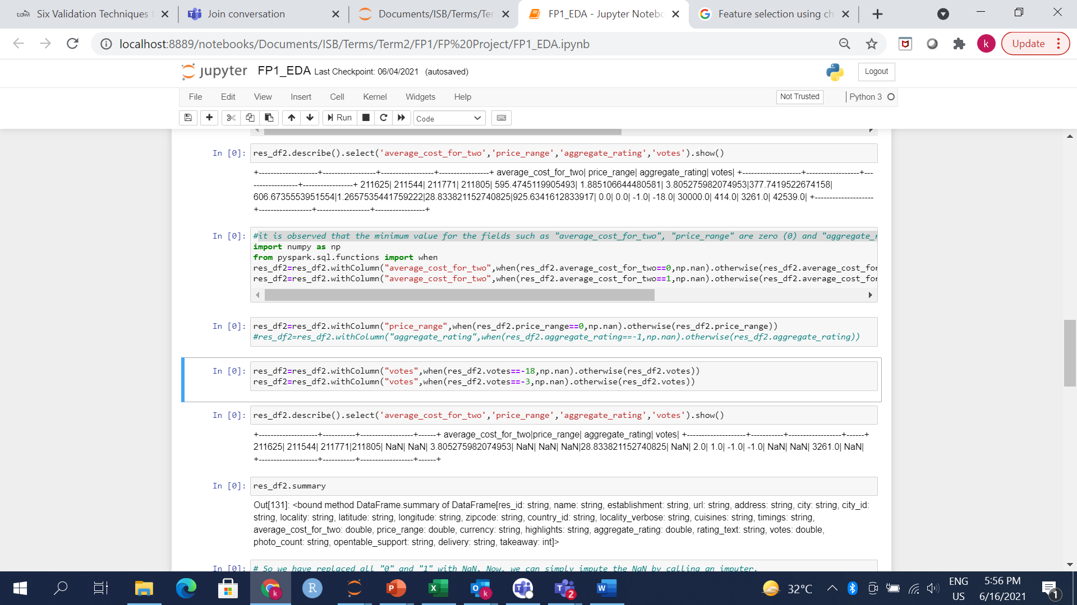
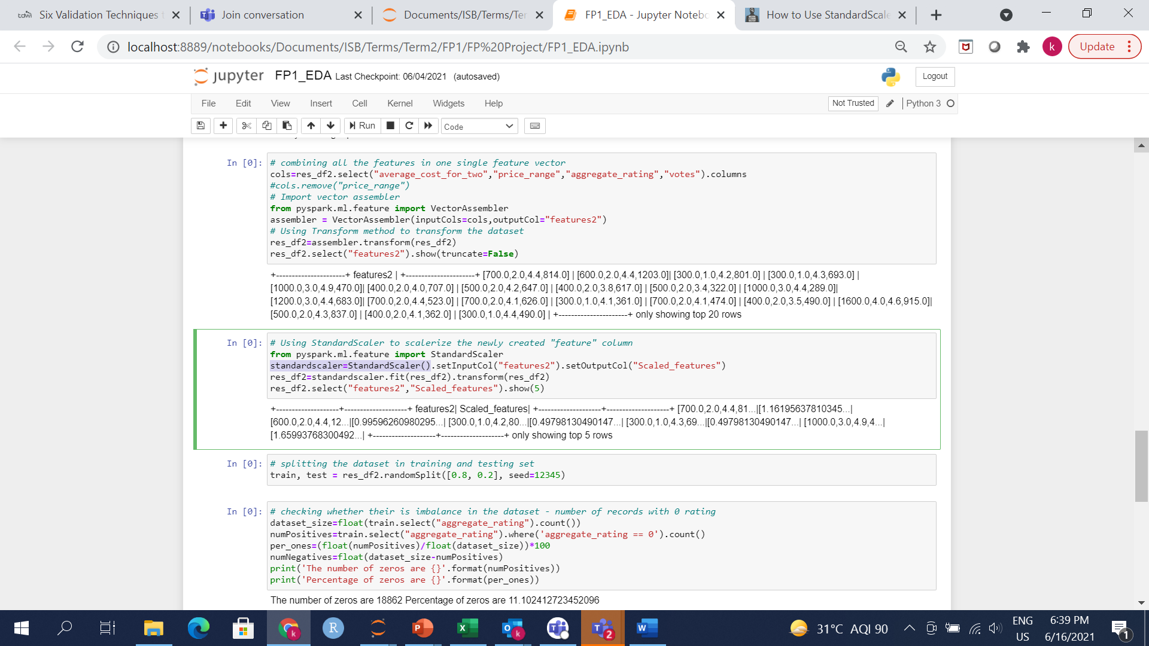
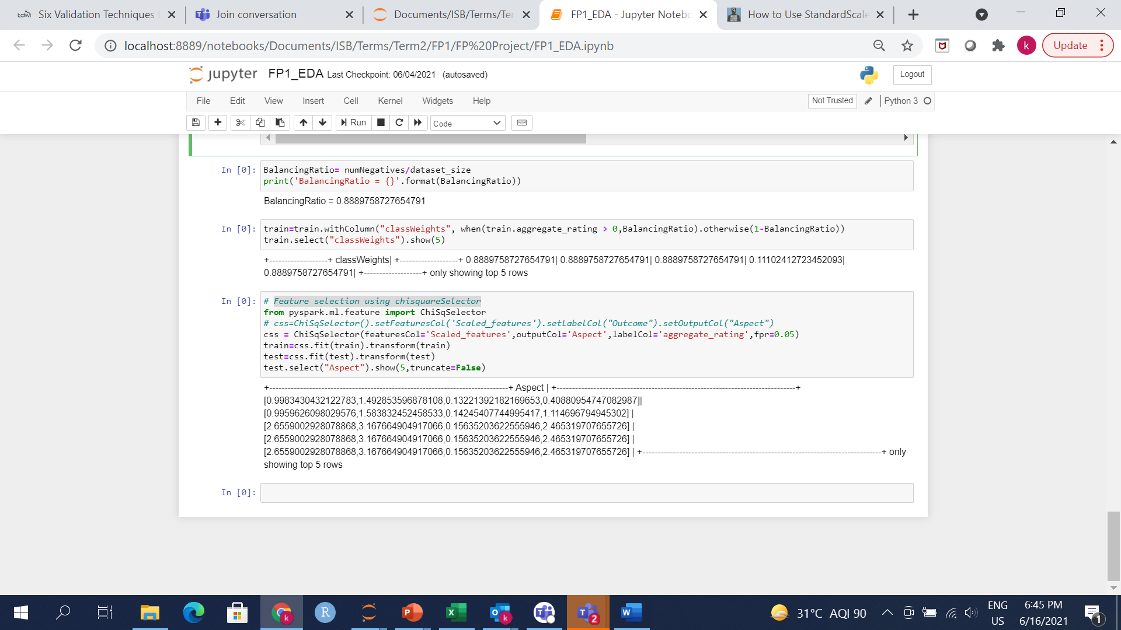
Data Preparation: Select the data
Raw Data
Food Outlet/Restaurant data, User data, Order data
Data Cleaning
Data processing
Data selection & standardization
Identifying missing and null value in Restaurant data
Eg: Minimum value for the fields such as "average_cost_for_two", "price_range" are zero (0) and "aggregate_rating", "votes" are -1. Replacing 0 and -1 with Average ratings /NaN
Numerical imputation (Using Imputer )
Managing outliers (Median)
Combining features in one single vector feature (Average cost for two, rating, price range, votes )
Normalization through Standard Scaler
Imbalanced data handling
On splitting the data , only 11.1% were negatives (low rating)) and 88.9% were positives
Logistic loss objective function treated the positive class with slightly higher weight. For this purpose we calculate the BalancingRatio as follows:
#BalancingRatio= numNegatives/dataset_size
Notes:
https://machinelearningmastery.com/standardscaler-and-minmaxscaler-transforms-in-python/
Oversampling can be defined as adding more copies of the minority class. Oversampling can be a good choice when you don’t have a ton of data to work with.
We will use the resampling module from Scikit-Learn to randomly replicate samples from the minority class.
Important Note
Always split into test and train sets BEFORE trying oversampling techniques! Oversampling before splitting the data can allow the exact same observations to be present in both the test and train sets. This can allow our model to simply memorize specific data points and cause overfitting and poor generalization to the test data.
After resampling we have an equal ratio of data points for each class! Let’s try our logistic regression again with the balanced training data.
Our recall score increased, but F1 is much lower than with either our baseline logistic regression or random forest from above. Let’s see if undersampling might perform better here.

Slide 12
Business & Data Understanding
Data Preparation
The Modeling and Evaluation
Deployment
Monitoring and Maintenance

Slide 13
The Modeling and Evaluation

Slide 14
Modeling - Quality Measures & Evaluation
Performance [ref]
  F1 Score
  Confusion Matrix
  Mean Square Error
Robustness
  Dataset sanctity
  Detection, Prevention against shilling attacks [ref]
Scalability
  Distributed computing
  Scalable algorithms
  Separation of Concerns at Infra level
Model Explainability [ref]
  Feature Importance
  Counterfactual Explanations
  Adversarial Perturbations
Model Complexity
  Multi-model recommender system
  Real-time Consolidator (Conditioner) layer
  Real-time reducer layer
  Hit/miss ratio feedback mechanism
Resource Demand
  Hybrid Deployment Model
  High compute power on training system
  Low Compute power, High Network power on prediction engines
* Existing research included in references

Slide 15
Modeling
Model Selection
  Collaborative filtering with ALS-WR
    user ratings of food items
    user ratings of restaurants
  FPM (Association Mapping)
    Food item set per order
    Food item ingredients
Online Food delivery – domain knowledge gathering
  Fulfilment
  Aggregation
  Social media impact – harnessing it for good
Model training
  Available data
  Train/Validate split
  Trained model logistics to production CI
Data availability
  Handling labelled data
  Handling unlabeled data
Harnessing pre-trained models
Model Compression[ref]
  SVD (Matrix Factorization)
  Knowledge Distillation
Ensemble methods [ref]
  ALS (on multiple factors) + FPM (on multiple factors)+ Usage History based scoring
Assuring reproducibility
  Method reproducibility
  Result reproducibility
Notes:
Recommender Systems
– Content Filtering
– Collaborative Filtering (CF)
– CF: Neighborhood Methods
– CF: Latent Factor Methods
1. Implement the ALS-WR
2. Implement FPM
3. Consolidate recommendations from ALS-WR on user rating, restaurant rating, and FPM on order item associations and food ingredient associations
4. Recommend highest weighted recommendations from the set

Slide 16
Multi-Model Recommender System
ID-Name Map
Model Inputs
Model Training
Trained Model
Order Id
FPM
Cart items-based recommender
Food Id Set
Reducer
Food Id
FPM
Ingredient-based recommender
Ingredient Set
Consolidator
Final set of Food, Restaurant names, resolved from IDs
…..
……
……
…..
User Id
Food Id
ALS-WR
Food rating-based CF recommender
Rating
User Id
ALS-WR
Restaurant rating-based recommender
Rest. Id
Rating

Slide 17
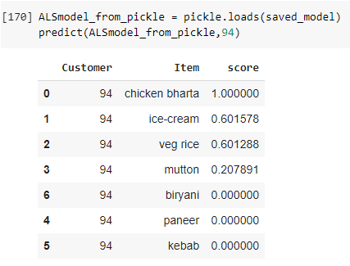
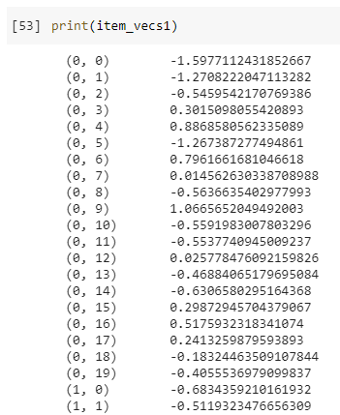
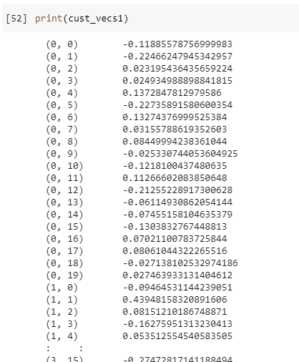
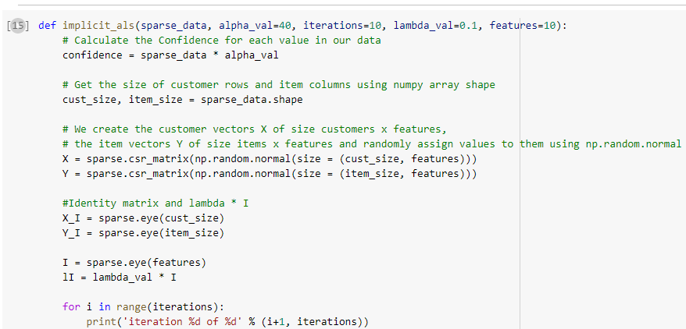
Code
Food Recommender System Code hosted at Google Colab [Source]

Slide 18
Business & Data Understanding
Data Preparation
The Modeling and Evaluation
Deployment
Monitoring and Maintenance

Slide 19


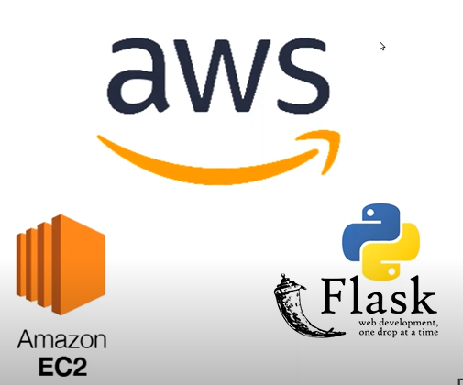
Deployment
Model-Service-Client + Retraining (MSC/R) [ref]
Model (data and trained model)
Service (model serving infrastructure)
Client (user interface)
Retraining (model monitoring and retraining)
Model serialization and pickling
Flask API Building
AWS EC2 Instance

Slide 20
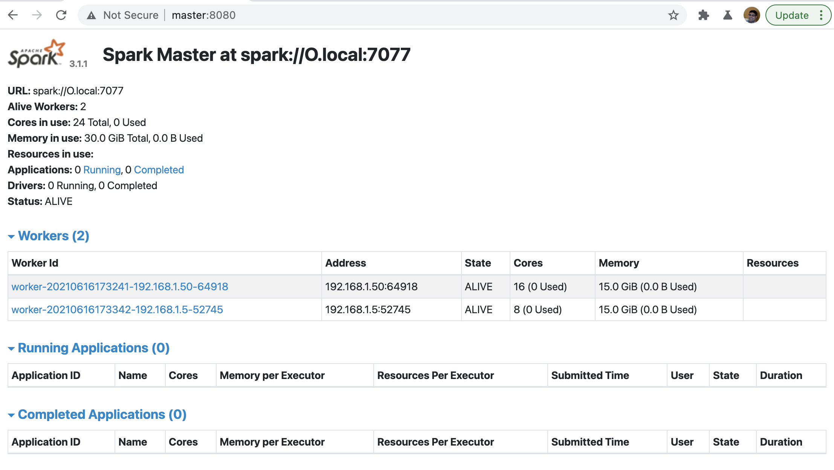
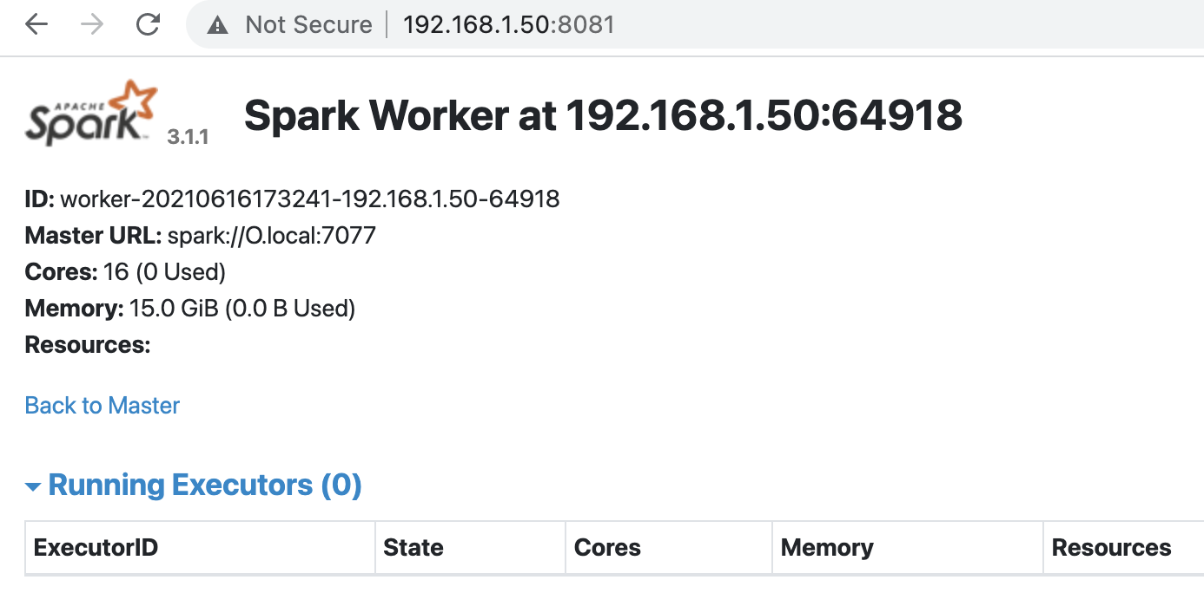
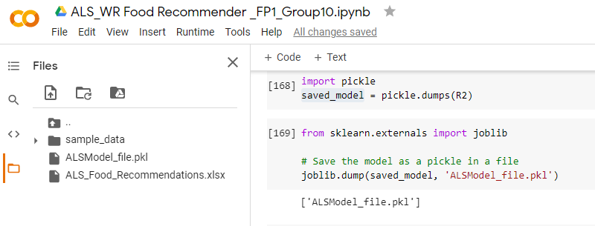
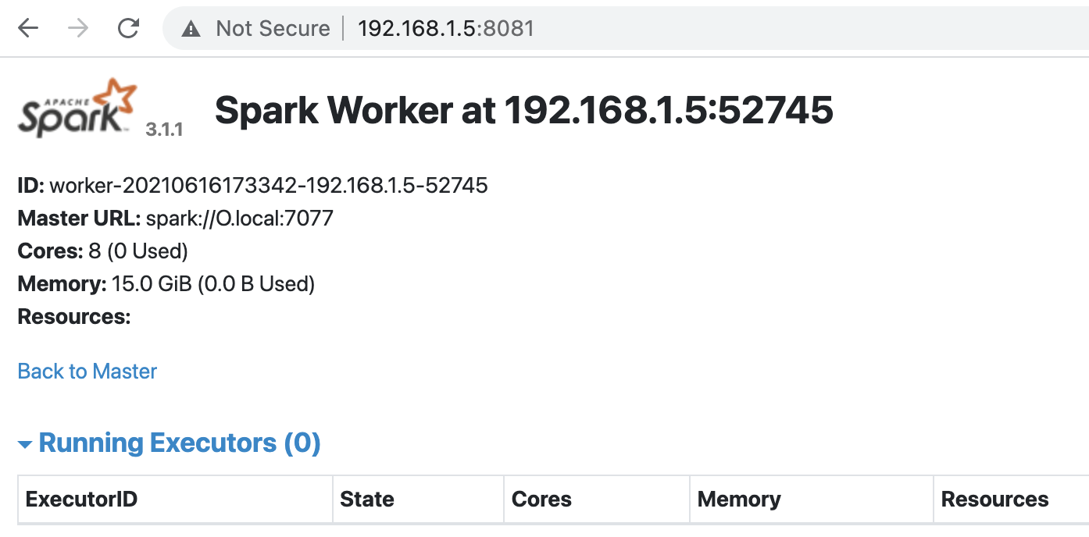
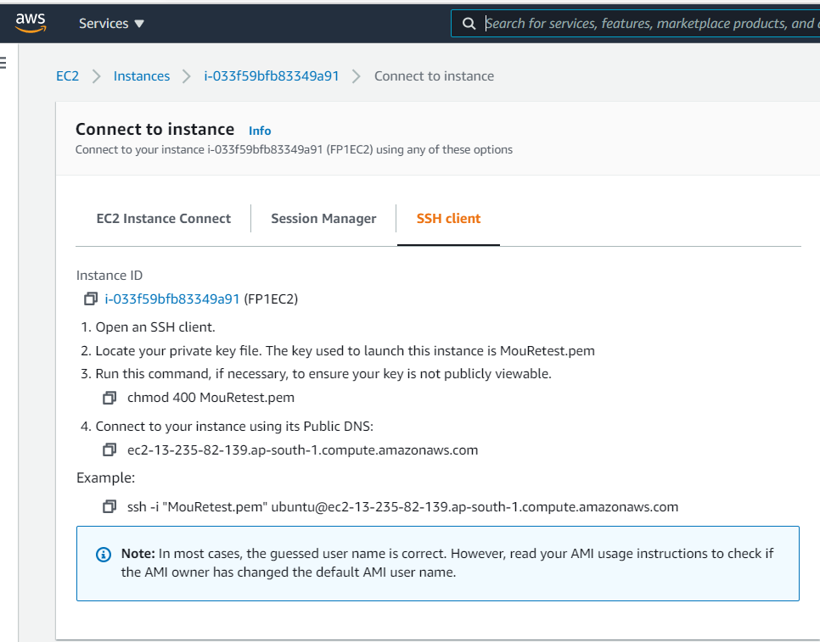
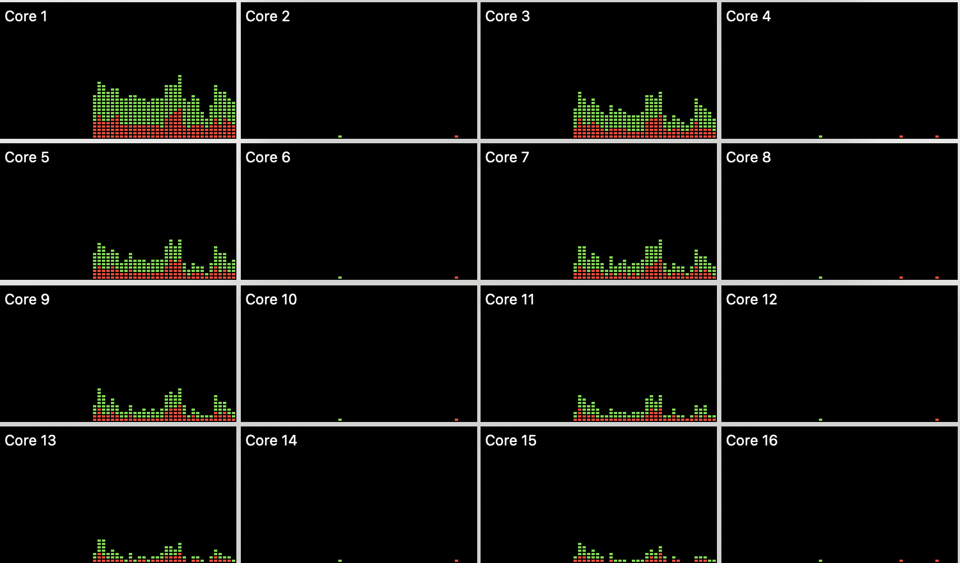
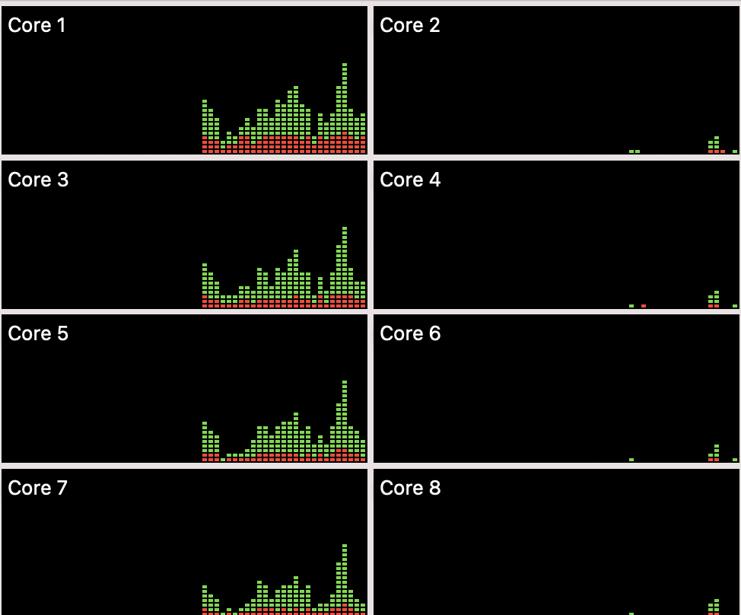
Hybrid Deployment Infrastructure
Spark Master, worker 1 – 16 Cores,16GB
Spark worker2 – 8 cores, 16GB
On Prem – High Compute system for Model Training
On Cloud – Recommender Web App

Slide 21
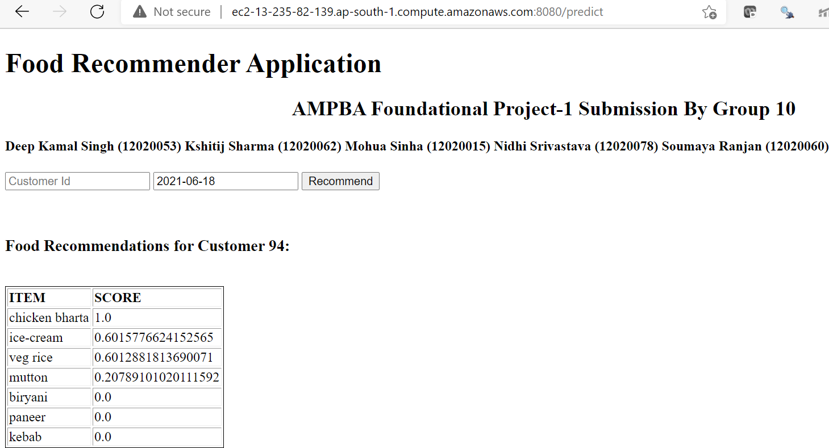
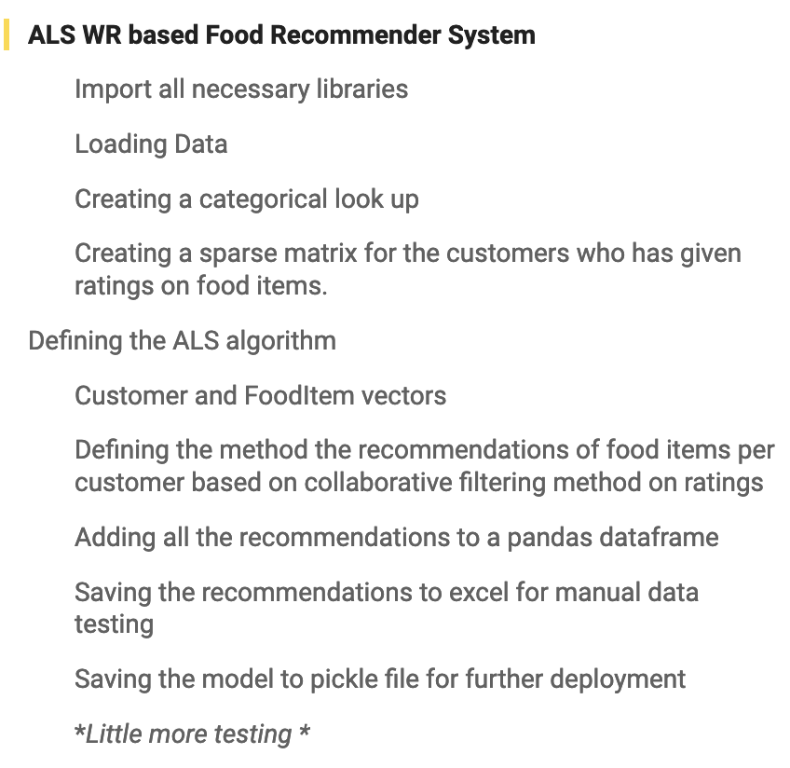
Food Recommender App
Recommendation Web App
ALS-WR model Training

Slide 22
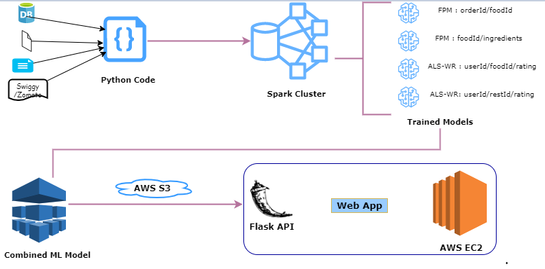
Recommender System High-Level Architecture

Slide 23
Business & Data Understanding
Data Preparation
The Modeling
Evaluation
Deployment
Monitoring and Maintenance

Slide 24
Monitoring and Maintenance

Slide 25
Model Monitoring and Maintenance
Nonstationary environment: Covariate Shift adaption [Ref]
Recursive Model Evolution
Hardware performance of ML models w.r.t metrics(runtime/energy consumption) [Ref]
Detecting Data Drift
Automate the management of Model Drift
Comparison of deployed model on benchmark distribution and real-world distribution
Collect and merge ground truth and predictions – recursive model evolution
Different tools to deploy concept drift aware ML model [Monitoring Tools]

Slide 26
SUBMISSION BY
  Deep Kamal Singh (12020053)
  Kshitij Sharma (12020062)
  Mohua Sinha (12020015)
  Nidhi Srivastava (12020078)
  Soumaya Ranjan (12020060)

Slide 27
Recursive model evolution
Unchanged Trained Model
Incoming requests
Randomizer
(Simple A/B experiment)
Variation induced Trained Model - 1
Recommendations
Model Score evaluation
Variation induced Trained Model - 2
Highest scoring model used for next day, along with tuned variants

Slide 28
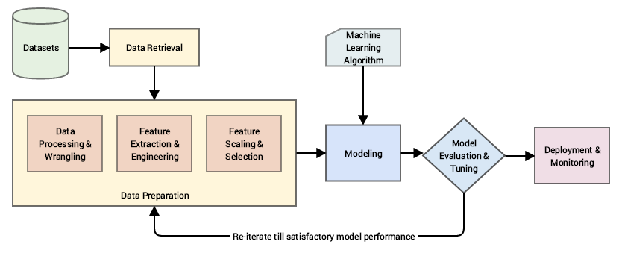
Machine learning pipeline
Need to customize it
Notes:
https://towardsdatascience.com/understanding-feature-engineering-part-1-continuous-numeric-data-da4e47099a7b

